Slide 1
LE26-114 What's new: Enhanced Power BI and Excel with Business Central
Kennie Nybo Pontoppidan
Joshua Martínez Pineda

Slide 2
Business Value
Frictionless demo of embedded Power BI
5 click install and configuration in demo companies
Maximize value of using Excel and Power BI
Users can analyze Power BI data in Excel. Agentic Excel
Understand customer loyalty and most selling items
Updated Power BI apps for Sales, Inventory, and Subscription Billing
Notes:
LE25-100

Slide 3
Enhanced Power BI and Excel (highlights)
5 clicks to Power BI demo (for demo companies)
Using Excel to browse Power BI models
Using Agentic Excel with Edit/Open in Excel
Using Fiscal calendars for Power BI apps
Updated Power BI apps for subscription billing, sales, and inventory

Slide 4
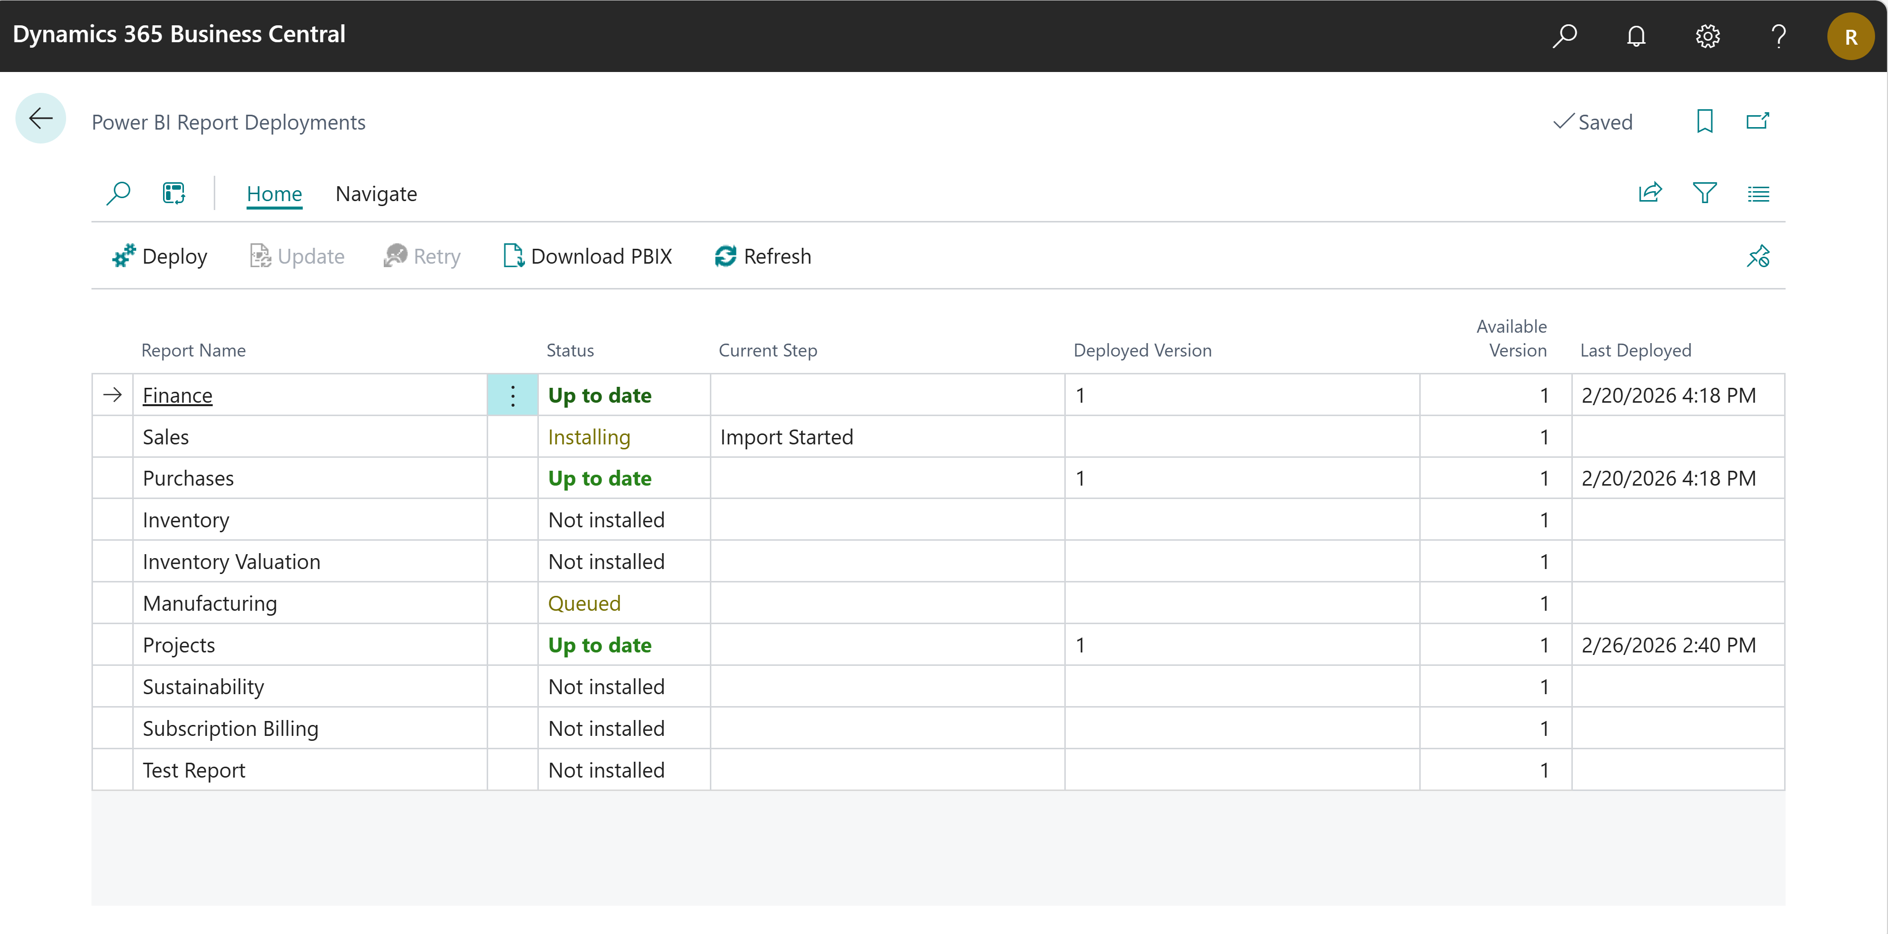
5 clicks to Power BI demo (28.x)
Setup embedded Power BI pages easily inside Business Central.
Only works for demo companies
Notes:
https://learn.microsoft.com/dynamics365/business-central/across-powerbi-install-business-central-apps

Slide 6
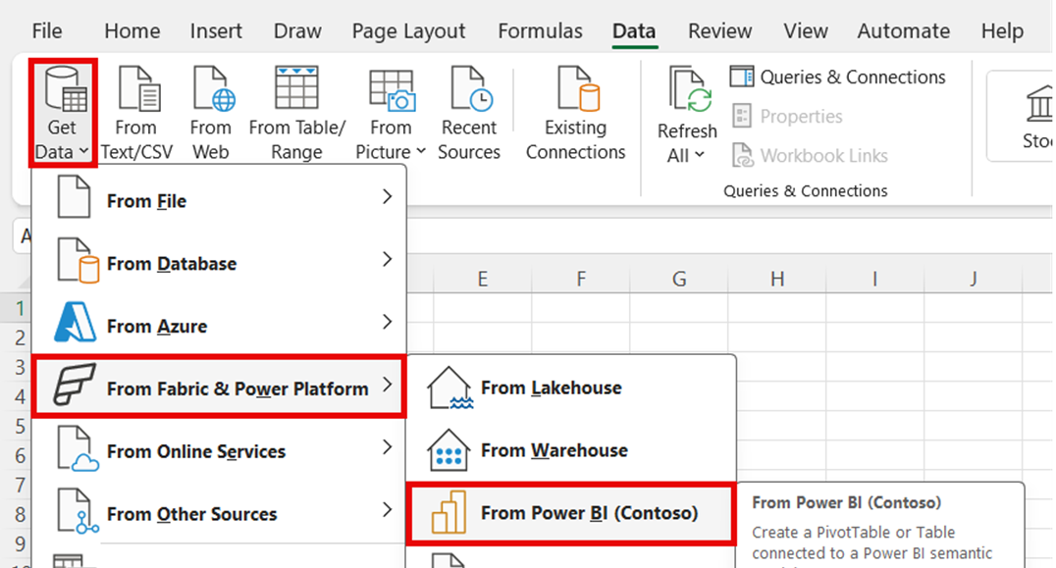
Using Excel to browse Power BI models
Slice’n’dice your data with Excel
Notes:
Use Agentic Excel to enhance data tasks
https://learn.microsoft.com/dynamics365/business-central/across-work-with-excel#use-agentic-excel-to-enhance-data-tasks

Slide 7
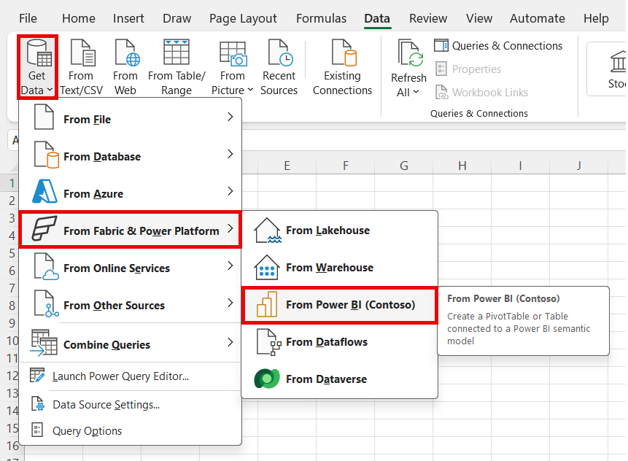

Slide 8
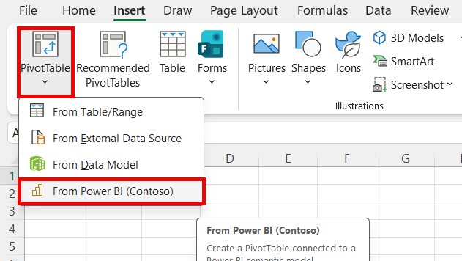

Slide 9
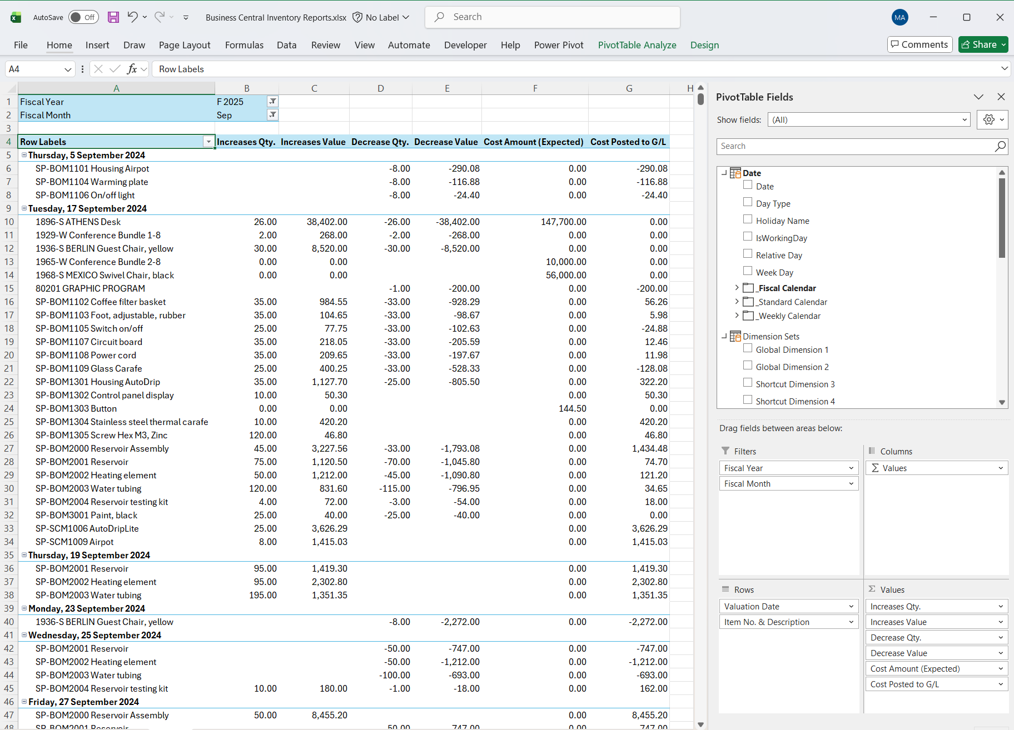

Slide 10
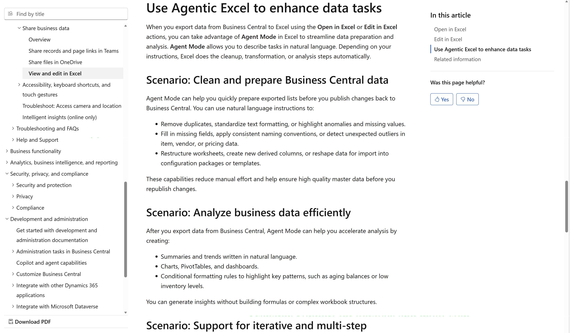
Using Agentic Excel with
Edit/Open in Excel
Notes:
Use Agentic Excel to enhance data tasks
https://learn.microsoft.com/dynamics365/business-central/across-work-with-excel#use-agentic-excel-to-enhance-data-tasks

Slide 11

Notes:
https://learn.microsoft.com/dynamics365/business-central/across-work-with-excel#use-agentic-excel-to-enhance-data-tasks

Slide 12
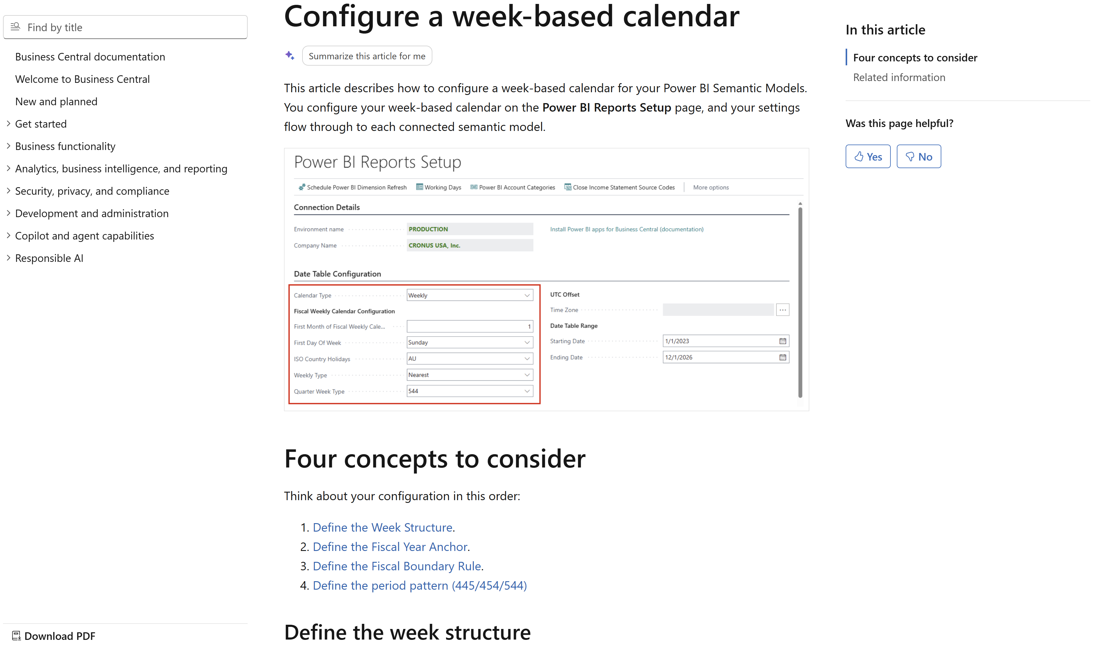
Using Fiscal calendars for Power BI apps
Notes:
Configure a week-based calendar (for Power BI apps)
https://learn.microsoft.com/dynamics365/business-central/across-powerbi-configure-week-based-calendar

Slide 13
Notes:
https://learn.microsoft.com/dynamics365/business-central/across-powerbi-configure-week-based-calendar

Slide 14
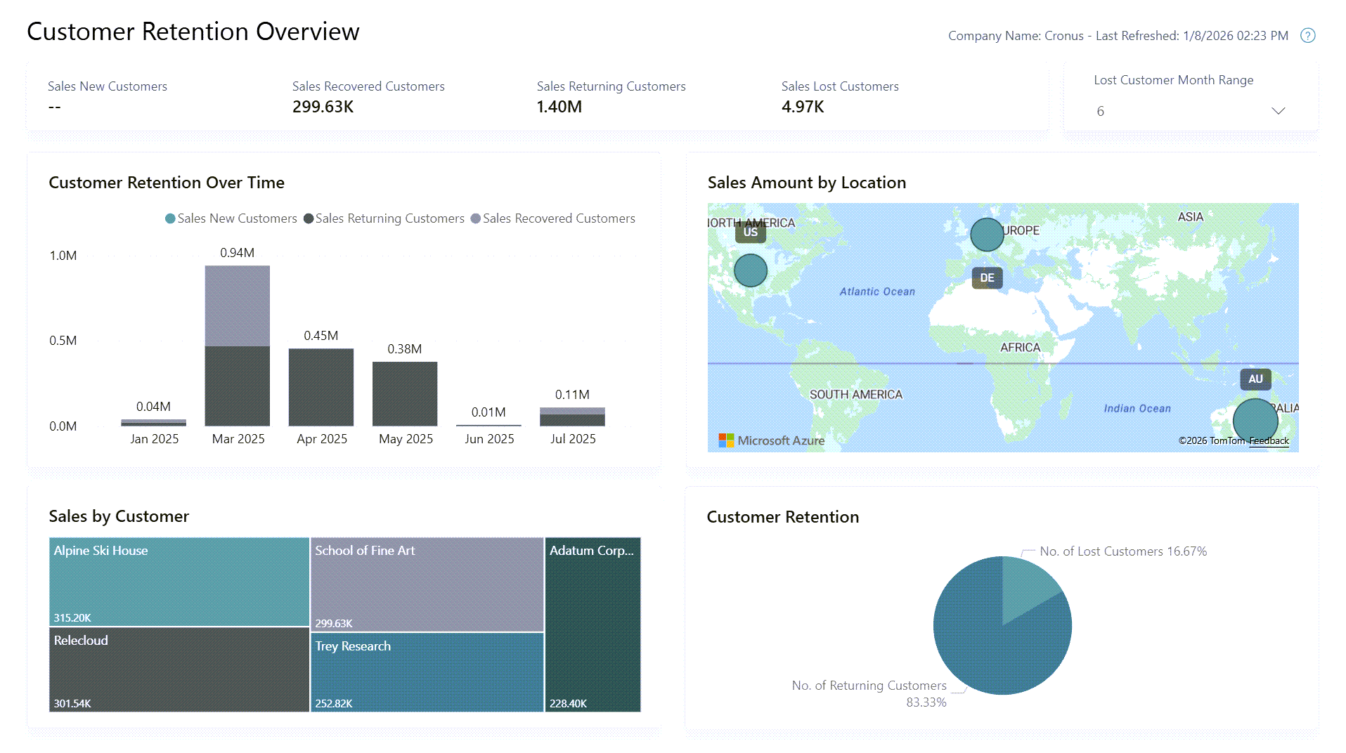
Updated Power BI apps for subscription billing, sales, and inventory
Sales: Customer loyalty
Inventory: ABC Analysis
Subscription Billing: Completely reworked all Power BI reports
Notes:
Opens these areas up for Power BI

Slide 16
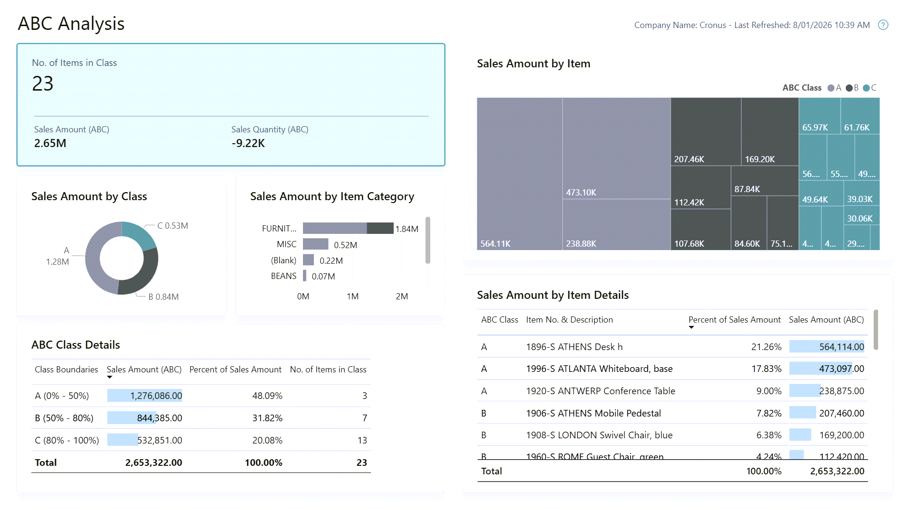

Slide 17
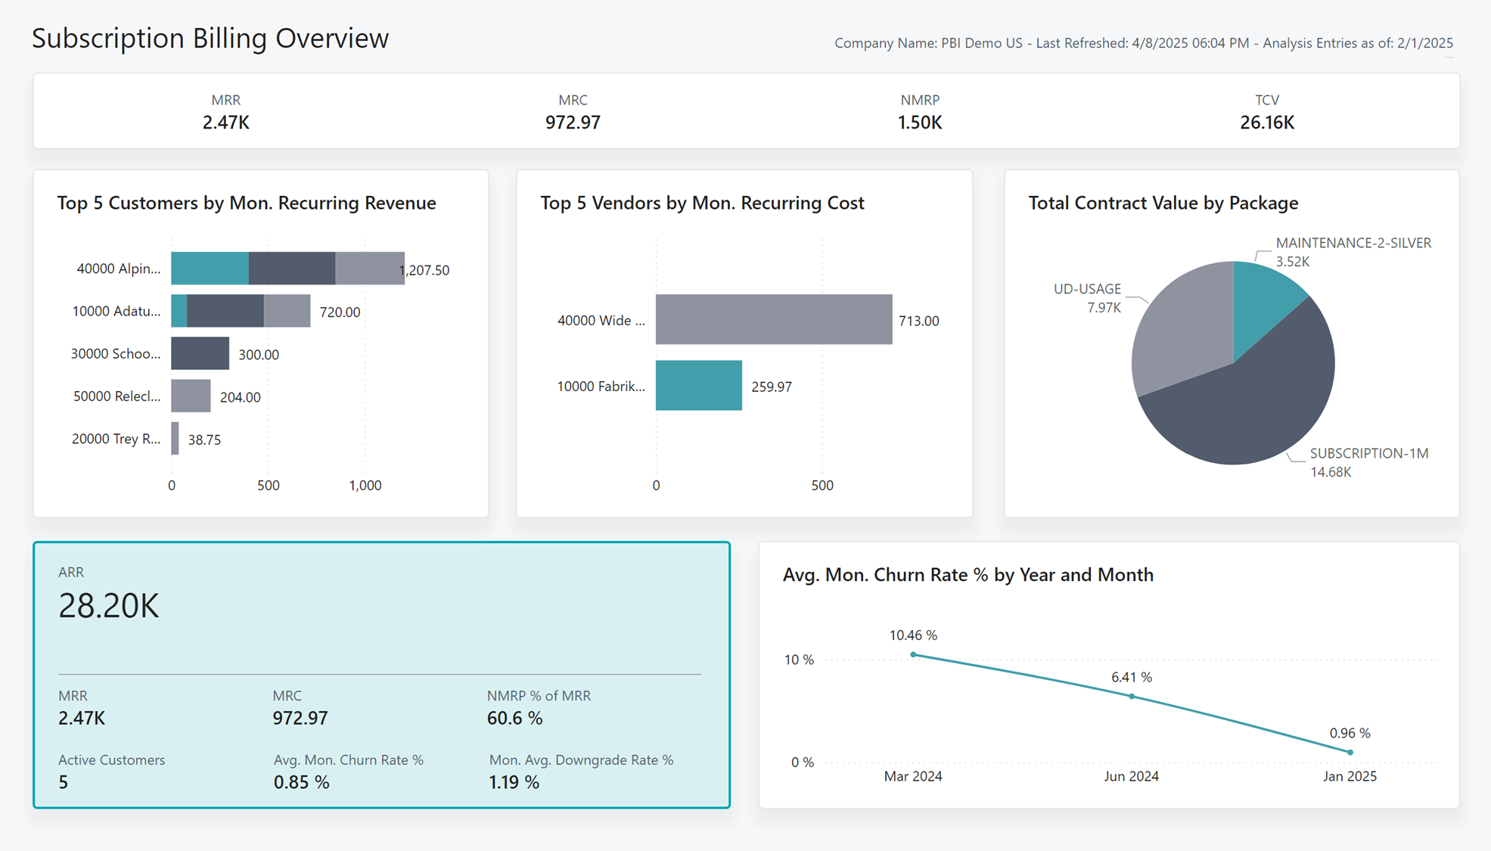

Slide 18
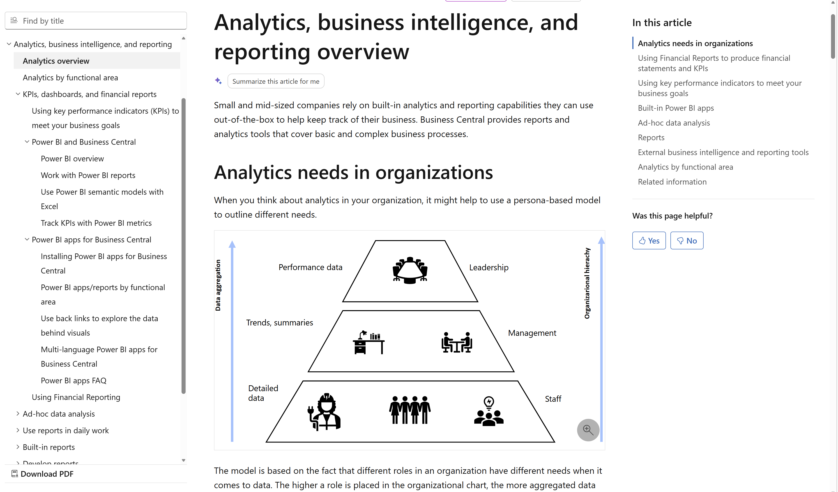
Want to learn more?
aka.ms/bcAnalytics

Slide 20
Related sessions
What's new: Enhanced sales analytics
What's new: Enhanced inventory analytics
What's new: Enhanced finance analytics
What's new: Enhanced Financial Reporting
What's new: Enhanced subscription billing analytics
What's new: Enhanced Analysis Mode
What's new: Enhanced demo data

Slide 21
General Business Central resources
Learn more!
Looking for resources?
Watch more on YouTube
aka.ms/BCAll
aka.ms/BCYouTube
Join Viva Engage to ask questions
Follow on LinkedIn
aka.ms/BCLinkedIn
aka.ms/BCVivaEngage
Join the office hours
Microsoft page for partners
aka.ms/BCOfficeHours
aka.ms/BCPartnerPortal

Slide 22



LinkedIn
Follow the weekly news and announcements
on the Microsoft Dynamics 365 Business Central page
aka.ms/BCLinkedIn

Slide 23

Watch more videos on YouTube
One-stop shop to watch Business Central videos:
  What is new
  Copilot and AI
  Short tips and tricks
  Technical deep dives
  Under the Hood podcast series
aka.ms/BCYouTube

Slide 24
THANK YOU

